Slide 1
PRESENTATION BY HON JOSEPH CUDJOE Minister for Public Enterprises 12TH July 2023
MINISTER’S PRESS BRIEFING
Theme: Improving Public Enterprises Portfolio

Slide 2
OUTLINE
Introduction
Overview of the Public Enterprises Sector
Achievements So Far
Restructuring of Public Enterprises Portfolio
Improved Compliance Reporting Transparency &
Accountability
Interaction And Capacity Building Initiatives
Way Forward
Conclusion

Slide 3
Introduction
Established in 2021, the Public Enterprises Secretariat has a mandate to support the Minister for Public Enterprises to ensure effective oversight of SIGA and deliver profitable, efficient and effective outcomes for the State-Owned Enterprises (SOEs), Joint Venture Companies (JVCs) and Other State Entities (OSEs), collectively referred to as Specified Entities (SEs).
The implementation of this mandate has been followed up with interaction at several levels to ensure profitable outcomes.

Slide 4
OVERVIEW OF THE SECTOR
175 Specified Entities operating in various sectors of the economy
53 State Owned Enterprises
47 Joint Venture Companies
75 Other State Entities

Slide 5
Value of Portfolio of Specified Entities.
A study undertaken by the government and completed in 2019 estimated the market value of the State’s equity holding in 63 active entities at Ghc 35.7billion as at December 2016.
SOEs accounted for 92% of this value. The remaining 8% represented the State’s equity stake in JVCs

Slide 6
ACHIEVEMENTS SO FAR
RESTRUCTURING OF PUBLIC ENTERPRISES PORTFOLIO
IMPROVED COMPLIANCE REPORTING, Transparency and Accountability.
INTERACTION AND CAPACITY BUILDING INITIATIVES

Slide 7
Restructuring of Active Companies
Liquidation
Listing on the Ghana Stock Exchange
Strategic Investment and
Disposal
Disposal of Defunct Entities
RESTRUCTURING OF PUBLIC ENTERPRISES PORTFOLIO

Slide 8
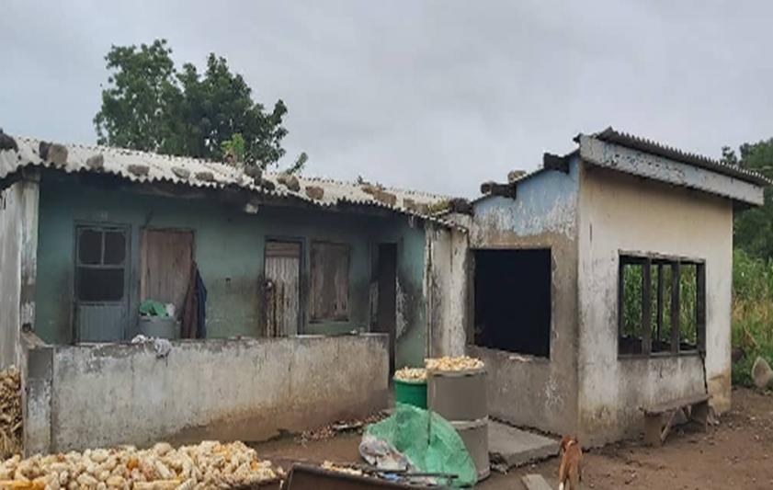
Assets of Inactive/Defunct Gov’t Entities
Aboso Glass Factory’s Central Stores
Bolgatanga Meat Factory (Bungalow)

Slide 9
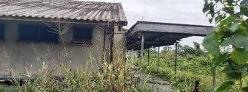
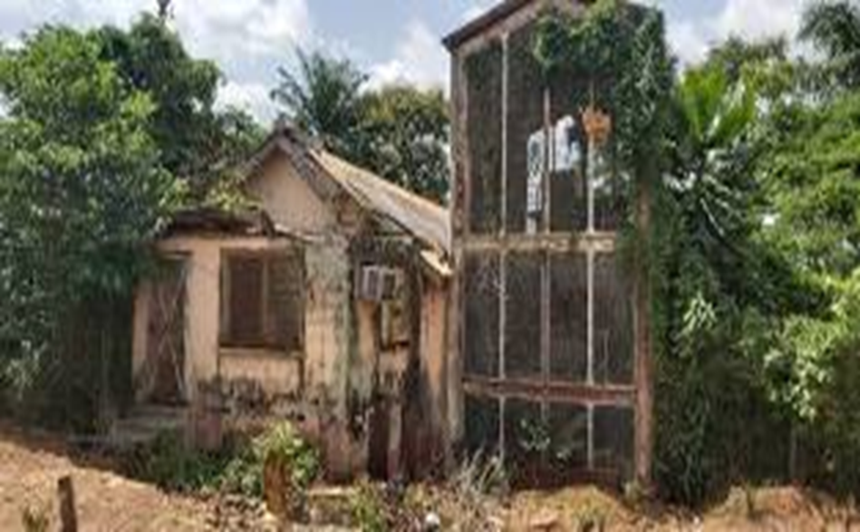
Assets of Inactive/Defunct Gov’t Entities
Bonsa Tyre Factory Clinic
Ghana Consolidated Diamonds Company (Research Laboratory)

Slide 10
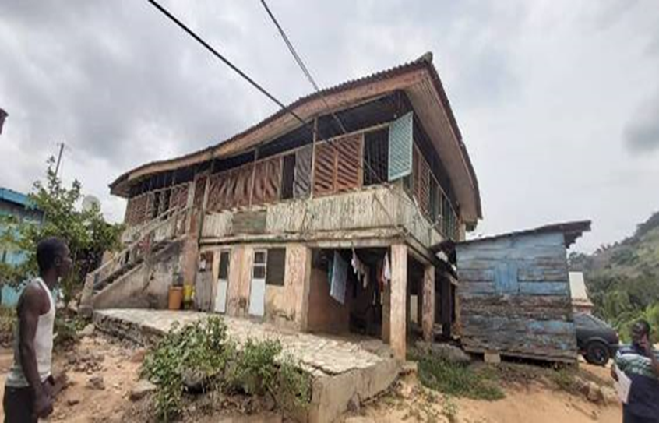
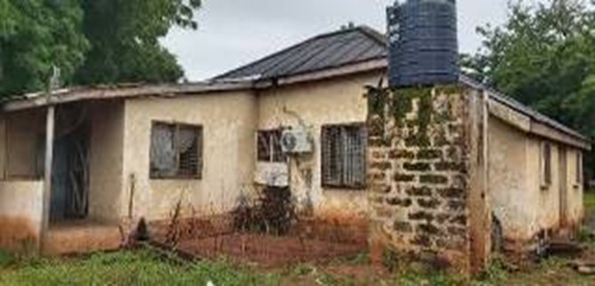
Assets of Inactive/Defunct Gov’t Entities
Ghana Food Production Corporation(Regional Office at Srodae)
State Construction Company (Guesthouse at Northern Region-Dagomba Street)

Slide 11
IMPROVED COMPLIANCE REPORTING, TRANSPARENCY AND ACCOUNTABILITY
YEAR | NO. OF ENTITIES THAT
 | SIGNED PERFORMANCE CONTRACTS | PREPARED AND SUBMITTED ACCOUNTS |  |  | COVERED IN NATIONAL ACCOUNTS
 |  | AUDITED | UNAUDITED | TOTAL
2016 | 6 | 2 | 16 | 18
2017 | 25 | 5 | 44 | 49 | -
2018 | 41 | 44 | 33 | 77 | -
2019 | 47 | 65 | 41 | 106 | -
2020 | 63 | 79 | 53 | 132 | 19
2021 | 67 | 95 | 37 | 132 | 47
2022 | 63 | - | - | - | 62
2023 | 73 | - | - | - | -

Slide 12
SIGNED PERFORMANCE CONTRACTS

Slide 13
Prepared and Submitted Audited Accounts

Slide 14
Prepared and Submitted Unaudited Accounts

Slide 15
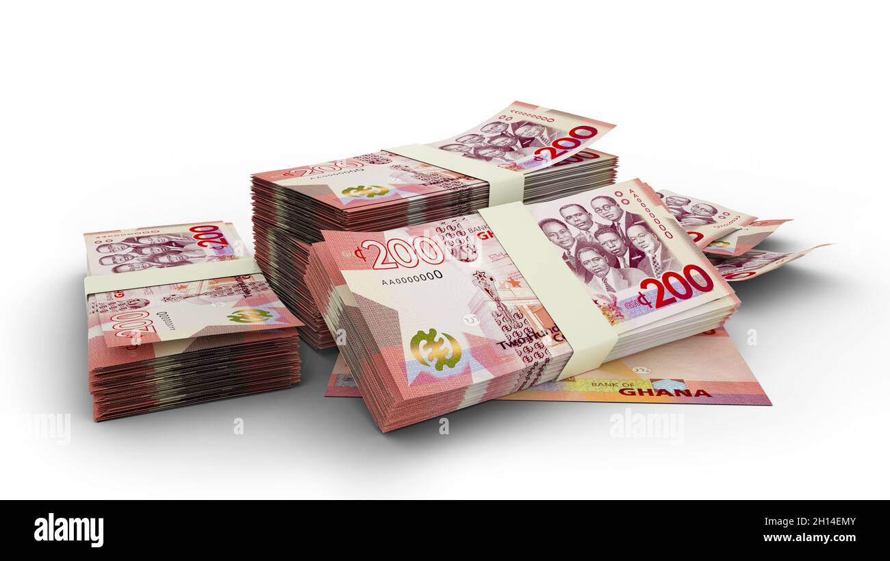
Entities covered in National Accounts

Slide 16
INTERACTION AND CAPACITY BUILDING INITIATIVES
Visits To Entities
Capacity Building Workshops

Slide 17
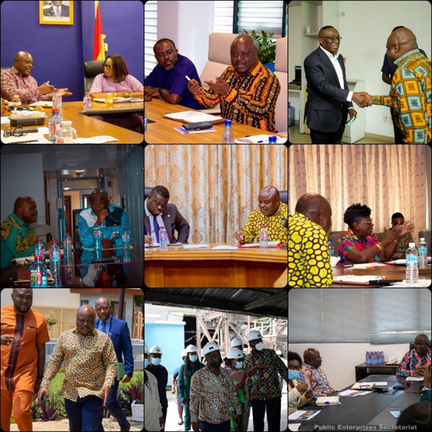
Visits to Entities
The Minister has had interactions with Boards and Management of some Specified Entities. To date he has interacted with 44 entities.
The visits helped to resolve pertinent issues relating to the entities. It afforded the entities the opportunity to raise challenges they were facing which required support and direction especially from SIGA.

Slide 18
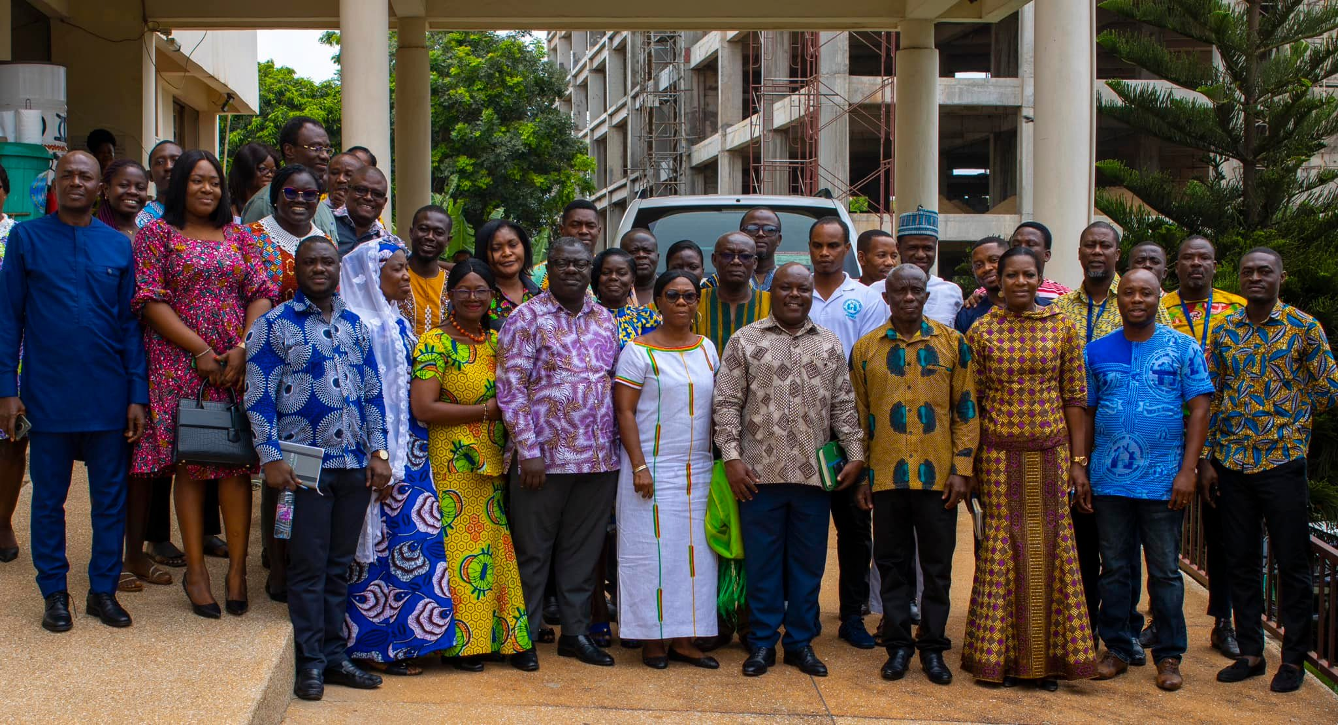
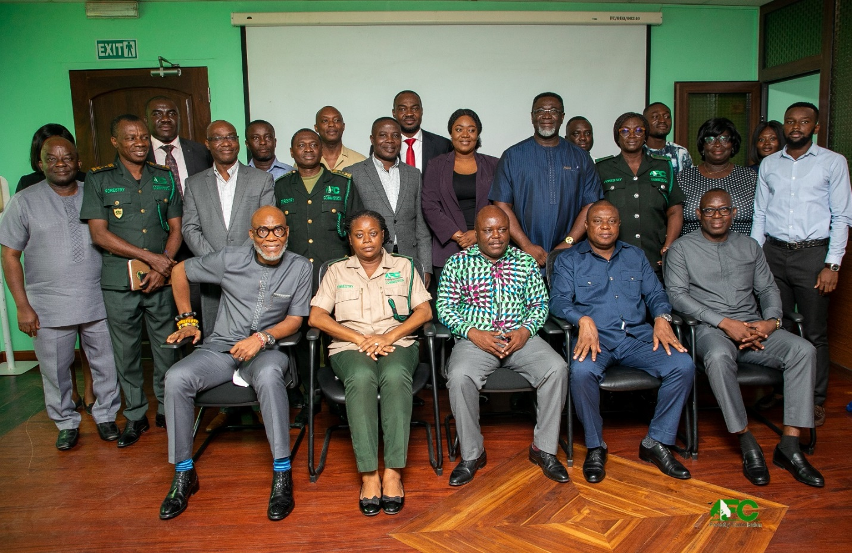
Visits to Entities
The Minister and His Team with staff of the Community Water and Sanitation Agency. (CWSA)
Hon. Minister with staff of the Forestry Commission.

Slide 19
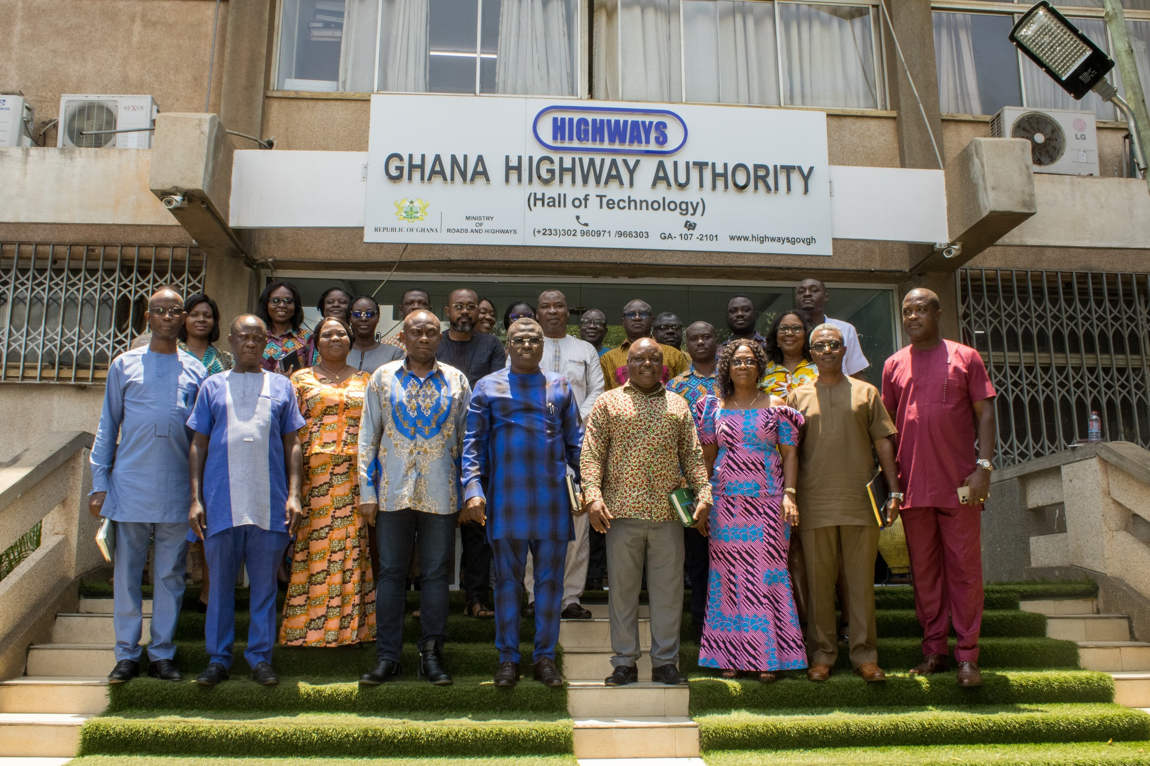
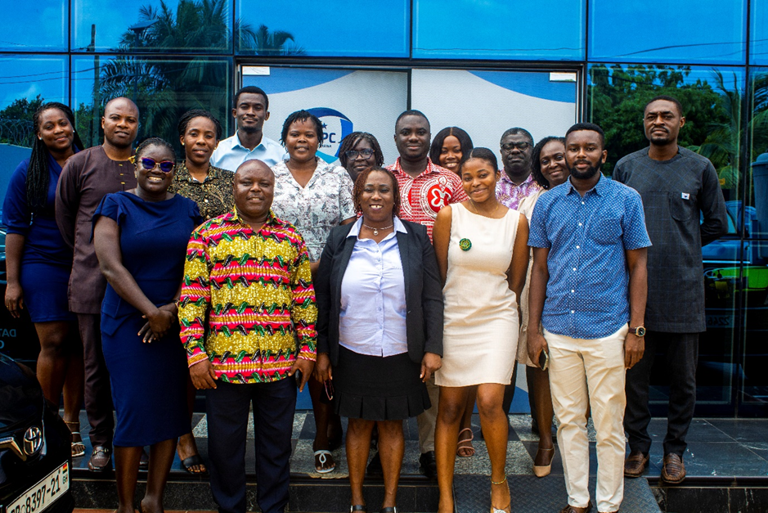
Visits to Entities
The Minister and Team with staff of Data Protection Commission.
Hon. Cudjoe with staff of the Ghana Highway Authority.
.

Slide 20
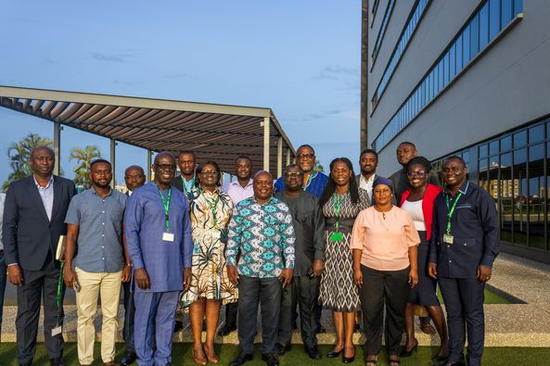
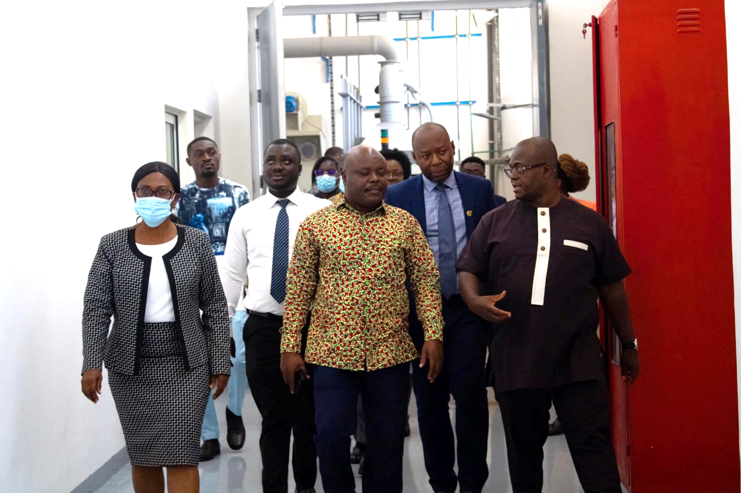
Visits to Entities
Hon. Minister with the National Pensions Regulatory Authority (NPRA)
Hon. Minister on a tour of the premises of Precious Mineral and Marketing Company. (PMMC)

Slide 21
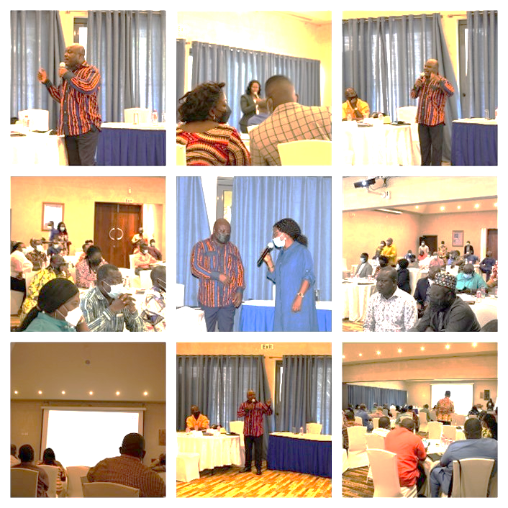
CAPACITY BUILDING WORKSHOPS
Capacity building workshops for Boards of Specified Entities was held in March 2022. This workshop developed their skills and capacities in four key areas which include;
Corporate Governance and the Board
Financial Stewardship and Accountability
Legal and Regulatory Framework for Specified Entities
Public Procurement for Specified Entities

Slide 22
CAPACITY BUILDING WORKSHOPS
A separate training was also organised on Corporate Governance for Board Secretaries.
This training was to enable them provide support to their Boards and strengthen their understanding of their duties.

Slide 23
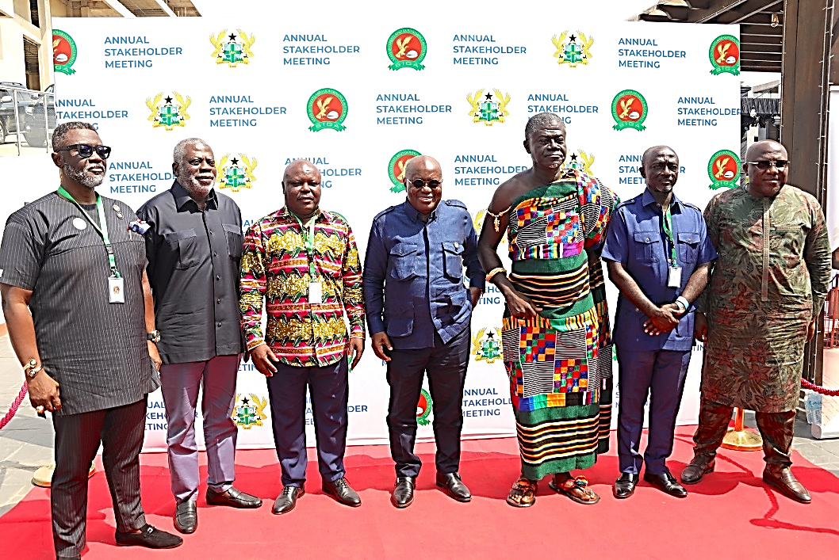
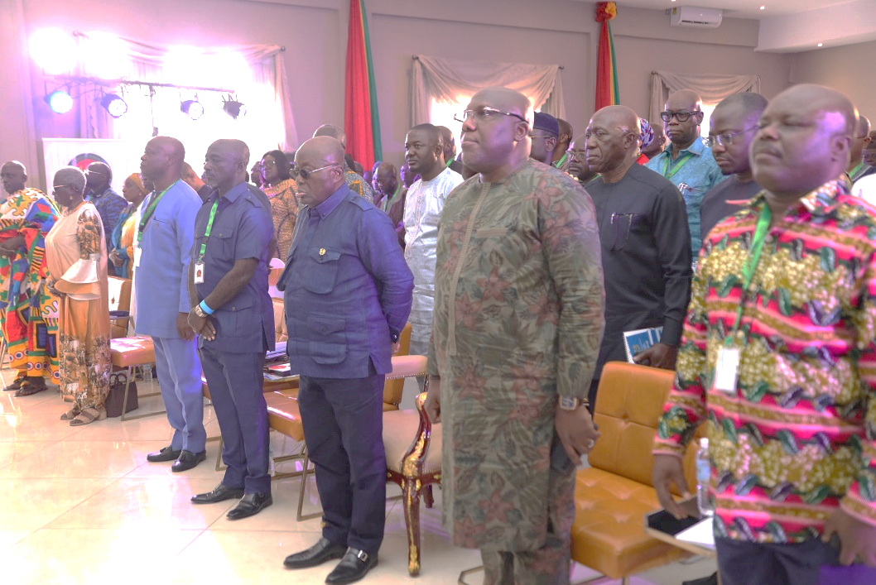
INTERACTIONS WITH STAKEHOLDERS
Annual Stakeholder Forum with Stakeholders, including Boards and Executive Heads of Specified Entities

Slide 24
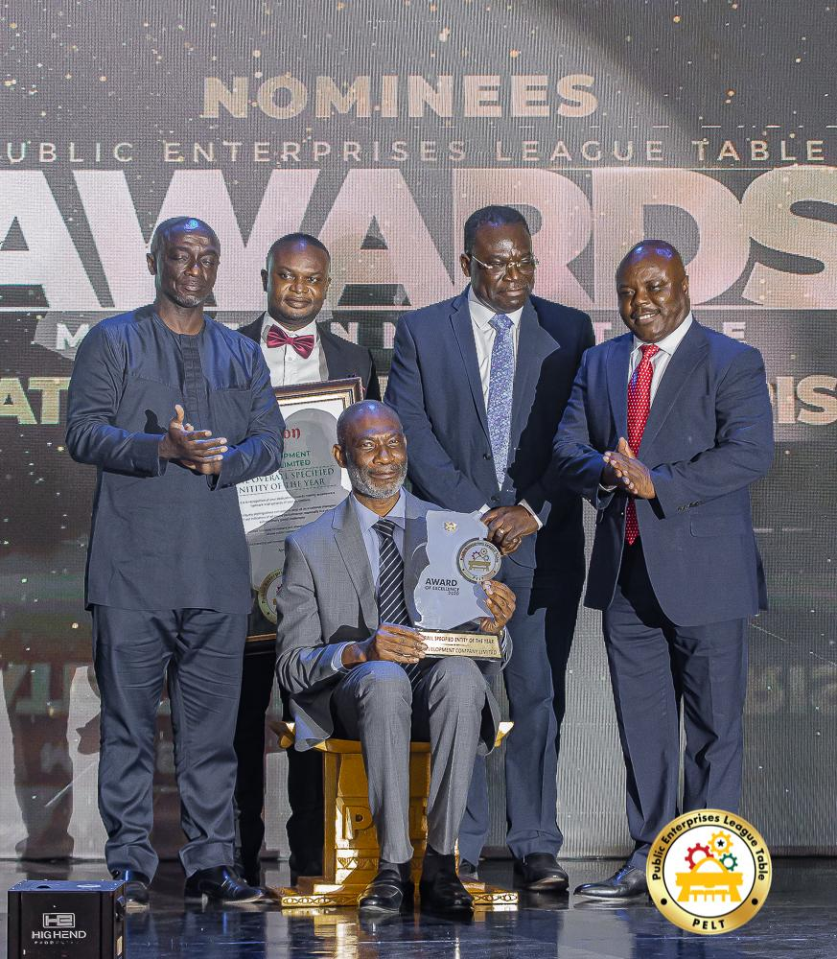
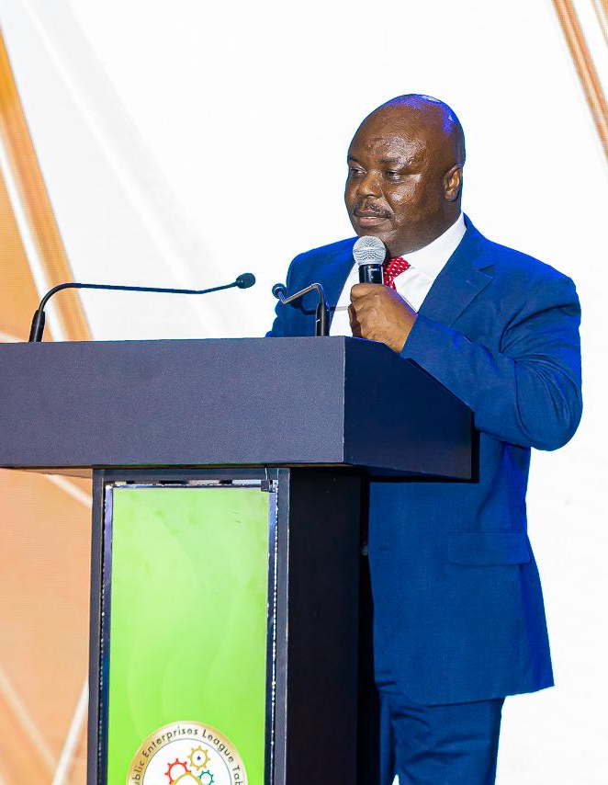
WAY FORWARD
1. PUBLIC ENTERPRISES LEAGUE TABLE (PELT)
The Public Enterprises League Table (PELT) is ranking tool for assessment of performance of Specified Entities.
It is based on performance indicators provided in the performance contract signed between SIGA and the Entities.
The PELT is expected to engender a healthy competition among the entities for improved performance and to recognise the best performing entities.
A maiden edition was of the league table was published last year and is expected to be held on an annual basis.

Slide 25
WAY FORWARD
FURTHER IMPROVEMENTS IN COMPLIANCE
RESTRUCTURING AND TURNAROUND PLANS OF THE ENTITIES
INTENSIFY ENGAGEMENT WITH PARLIAMENT
IMPLEMENTATION OF APPROVED POLICIES
State Ownership Policy
Code of Corporate Governance
DIGITALISATION AND REVENUE LEAKAGE RISK MITIGATION

Slide 26
CONCLUSION
Specified Entities will continue to play a significant role in the economy and opportunities exist for them to make real contribution to the development of the nation.
We are hopeful that going forward, their results would yield the desired outcomes.

